Slide 1

Team Nexus:
Alexander Hall, Benjamin Dluzak, David Kopp, Raffi Nalbandian, Vahan Tokadjian, Phillip Tran

Slide 2
Vision for Project Nexus
“To create a website that provides gamers with a social platform to interact with in-game character statistics, player made guides and additional information, and a way for players to find other individuals to play their favorite online games with.”

Slide 3
Project Nexus Roadmap
Website Characteristics
User Profiles
Instant Messenger
Discussion Forums
User(s) Game Statistics
Match Finder (Schedule Matching)
Environment
Jetty Server
Development Languages / Tools
Java, JavaScript, Maven, CSS, and HTML
AngularJS, Java Spark, Eclipse, 0xDBE, and Brackets

Slide 4
SLOC Production
Estimated SLOC:
10 KLOC
Actual SLOC:
3457 SLOC

Slide 5
Risk Analysis
Lack of testing
Mitigated by Junit testing
SCRUM and Communication Tool
Mitigated by migrating to Trello and Slack
Scope too large
Mitigated by de-scoping
Removed group pages and email service

Slide 6
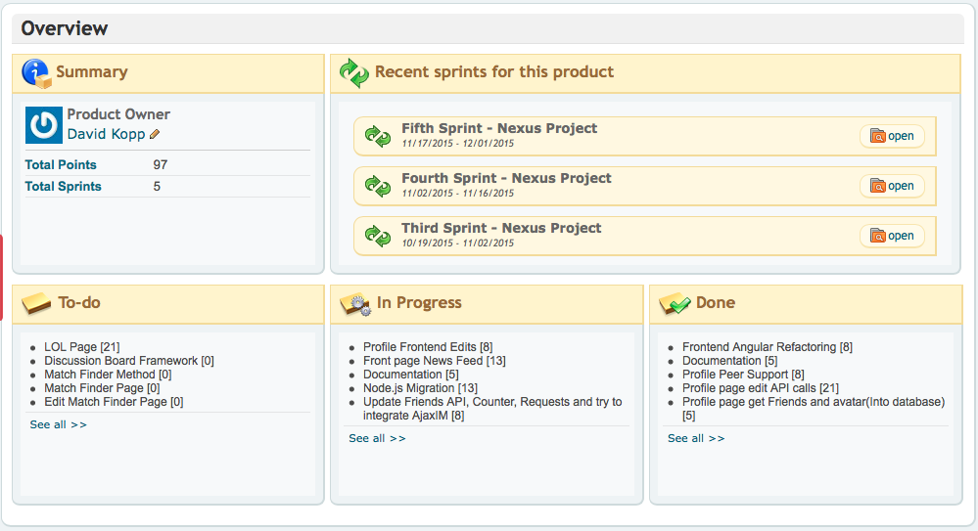
PAL PangoScrum
http://csuncomp380.pangoscrum.com/products/18898

Slide 7
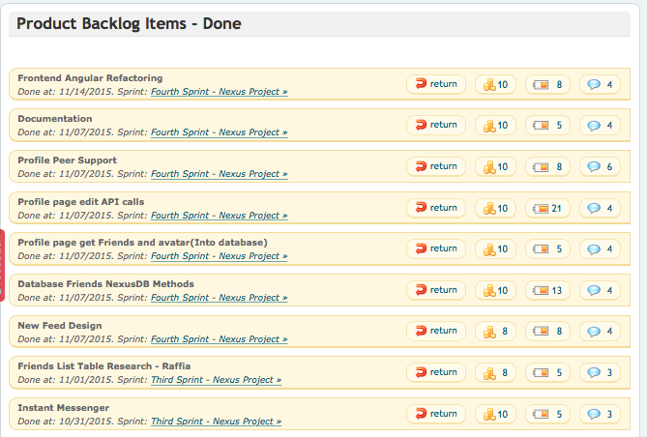
Products Produced

Slide 8
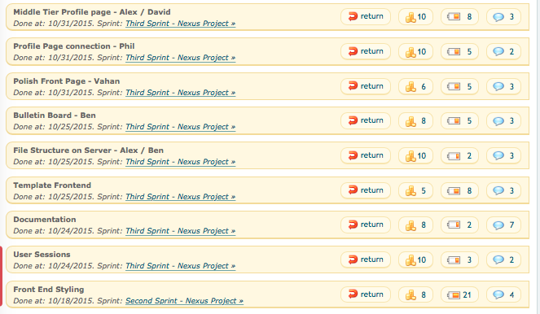

Slide 9
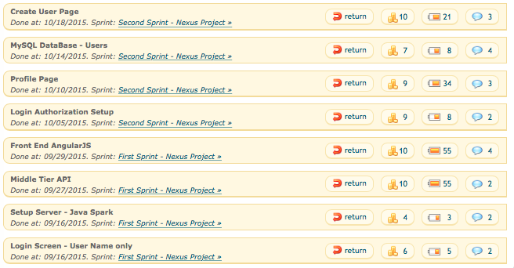

Slide 11
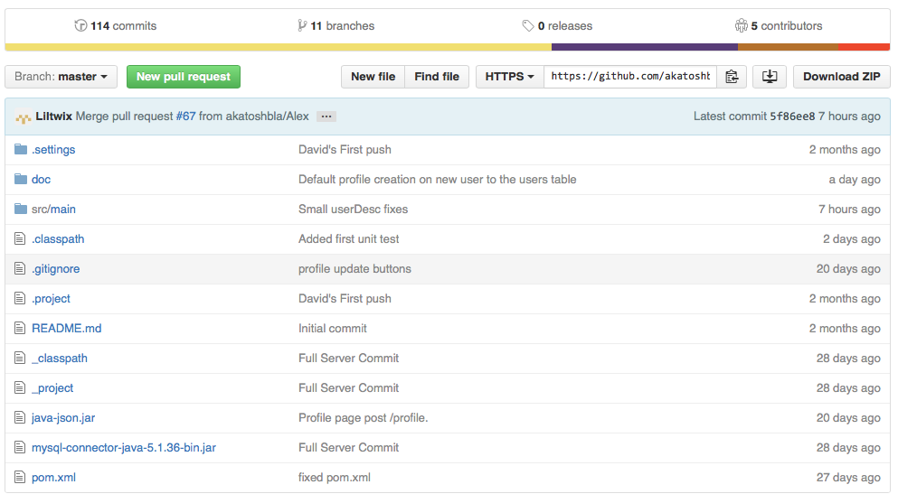
PAL GitHub
https://github.com/akatoshbla/Nexus

Slide 12
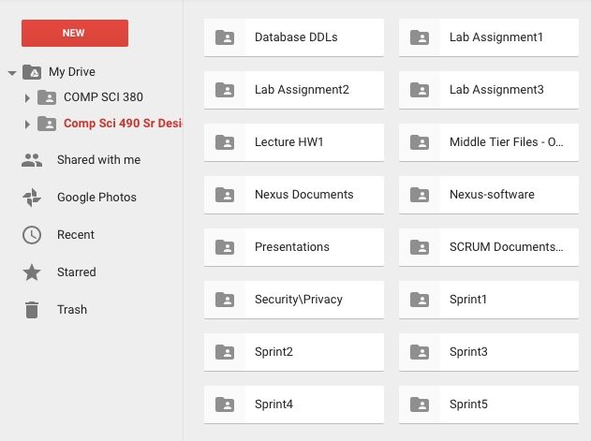
PAL Google Group
Google Drive Hyperlink

Slide 13
Process Retrospective
Worked Well
Sprints
Communication
Retrospective Meetings
Did Not Work Well
PangoScrum
Testing
Scope

Slide 14
Changes for Next Semester
Trello
Slack
Unit Testing
Re-evaluate Project Scope

Slide 15

Demo Incoming, Resistance is Futile

